Slide 1
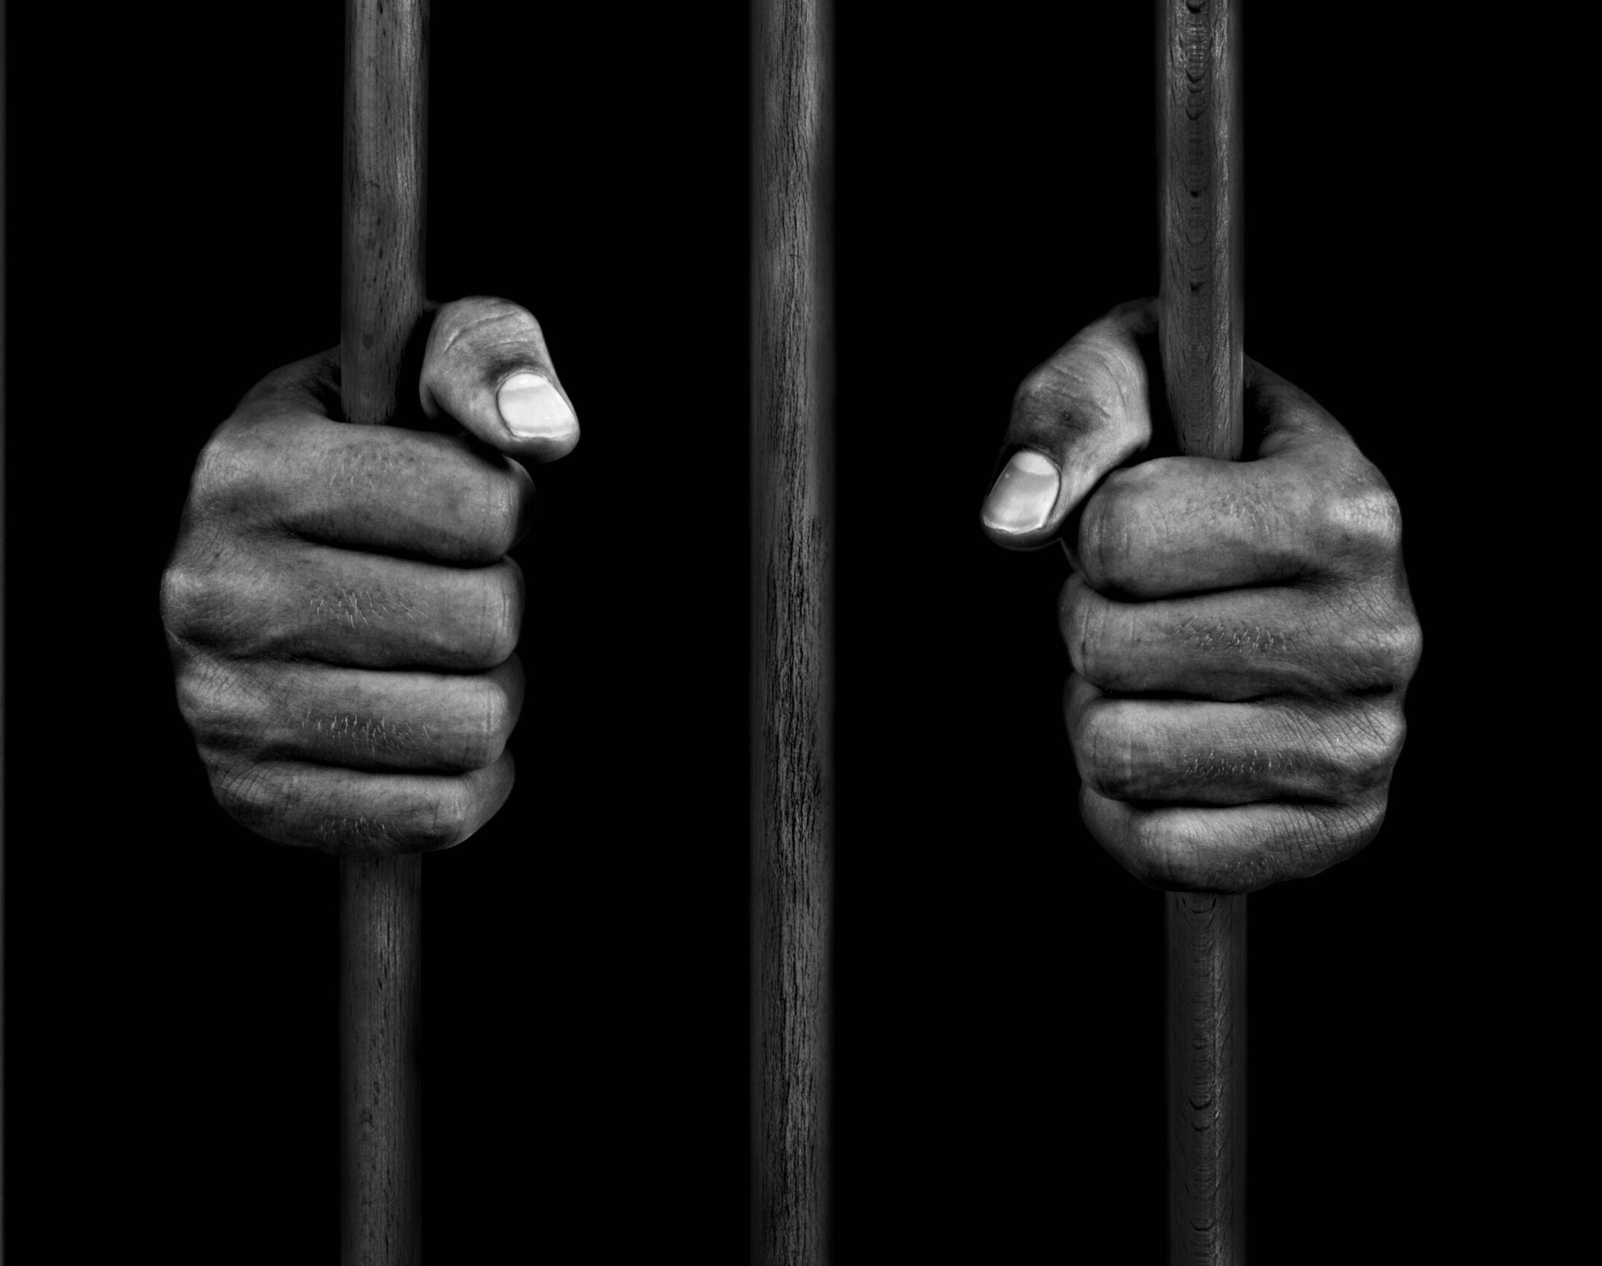
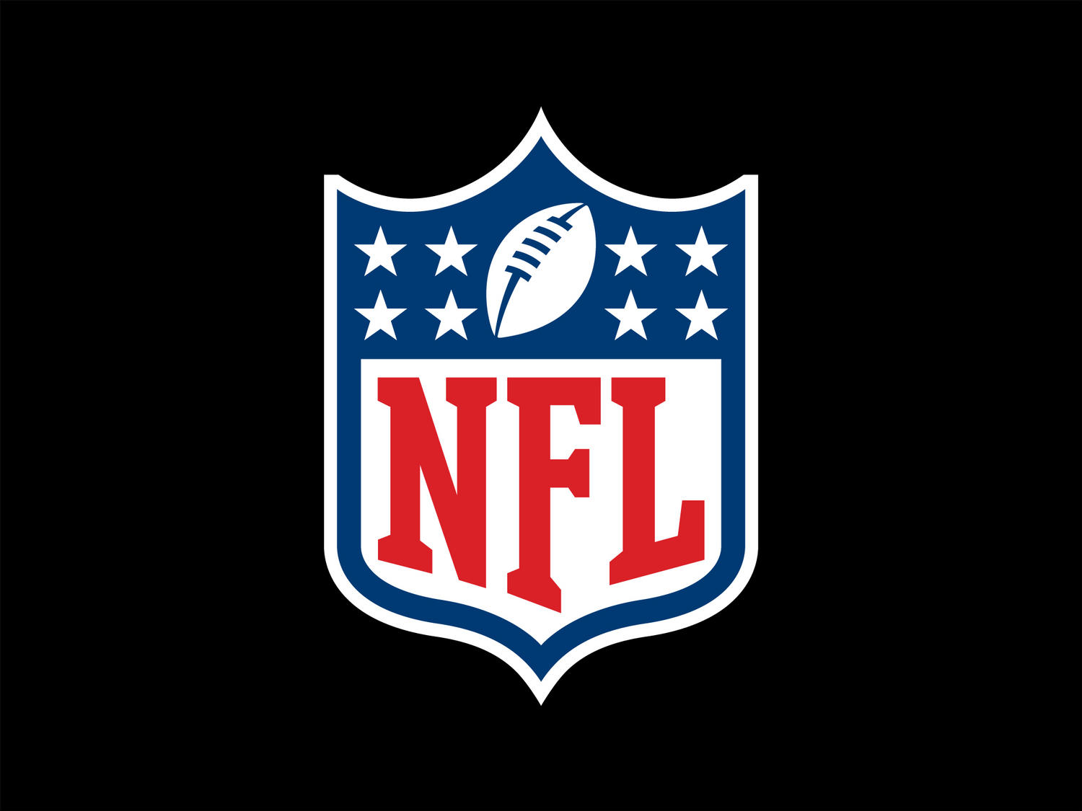
The Untold Truth of NFL Games
Emmanuel Presley
Damarje Brown
Joshua Hale
Raheem Yusuff

Slide 2
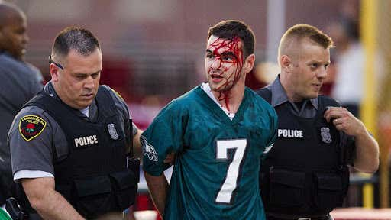
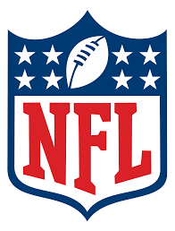
What is our project?
Are there any trends to predict which games are more “dangerous” (have more fans arrested) than others?
Business question: Can we predict what games we may need to have more police on site because we can expect that we will need to arrest more fans that game?
Inspiration:
Curious about a sport we all love
A lot of fan disputes and fights on social media, are NFL games really that bad? (Is it safe to take my kids?)
Disclaimer – throughout the project we became interested in other insights in addition to NFL game arrests

Slide 3
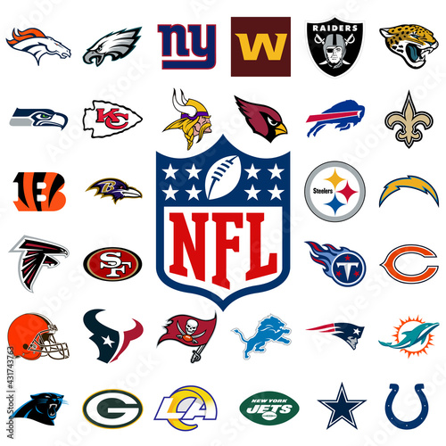
Research Questions
Is there any correlation between the total attendance of an NFL game and the number of arrests on any given game day at that stadium?
Which stadium is the most dangerous (which stadium has the most arrests)?
Is there any correlation between score gap and total number of arrests on that game day?
How strong is home field advantage?
What game day of the week has the best attendance per stadium?
What time of the day of games has the most arrests?
Does stadium type (dome or no dome) have any relationship with arrests?

Slide 4

Our Datasets
NFL Arrests
2011-2015 Seasons
Individual NFL Games
Teams
Score
Overtime
# of Arrests at the stadium on that gameday
NFL Games
2000-2019 Seasons
Individual NFL Games
Teams
Score
Day of the week
Date and Time
Total turnovers of each team
Total yards of each team
NFL Attendance:
2000 – 2019 Seasons
Grouped by Teams
Weekly Attendance
Season Total Attendance at all home games appended to each row
Season Total Attendance at all away games appended to each row
Season Total Attendance
Source: https://www.kaggle.com/datasets/washingtonpost/nfl-arrests/data
https://www.kaggle.com/datasets/sujaykapadnis/nfl-stadium-attendance-dataset

Slide 5

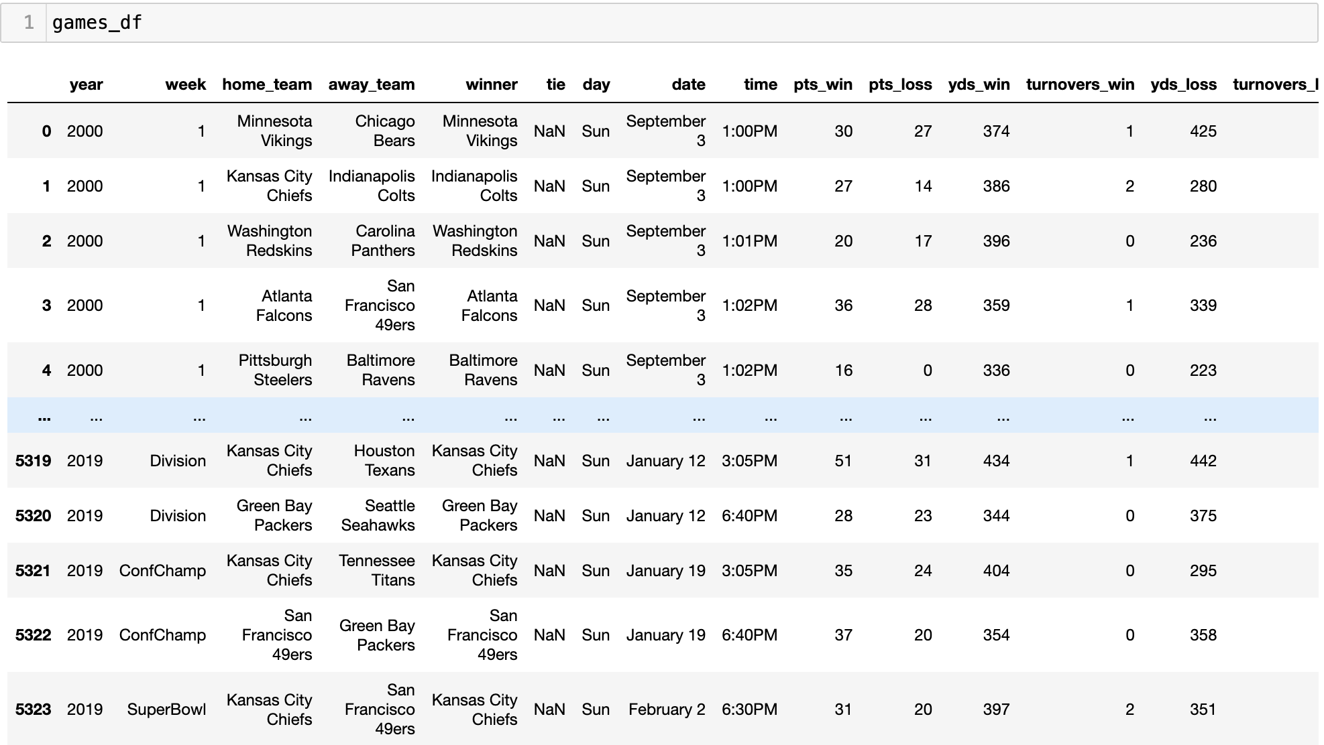
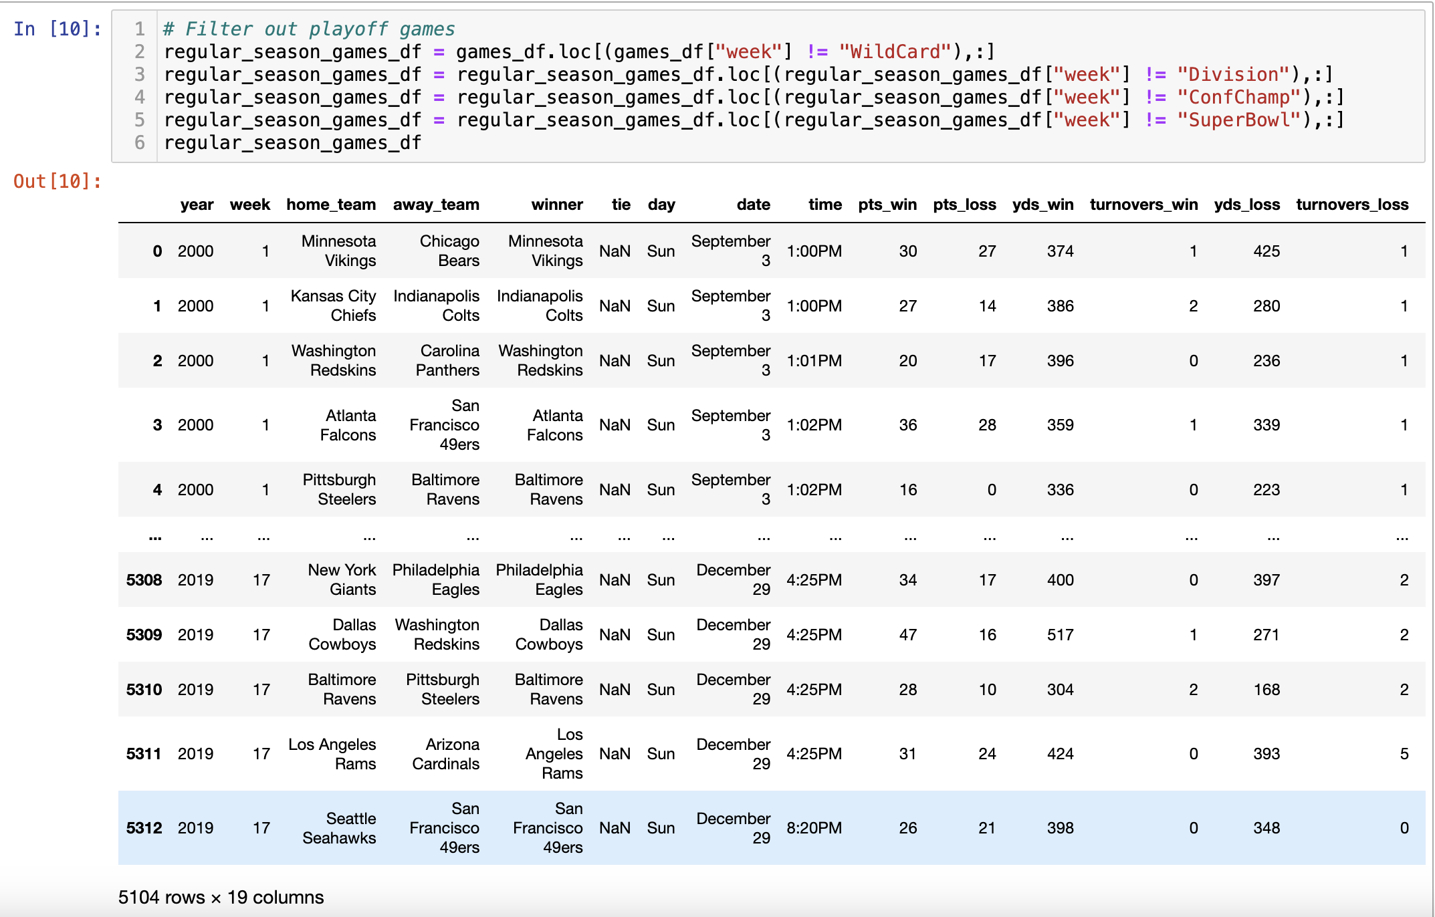
Data Engineering
Removed playoff games from Games dataset

Slide 6
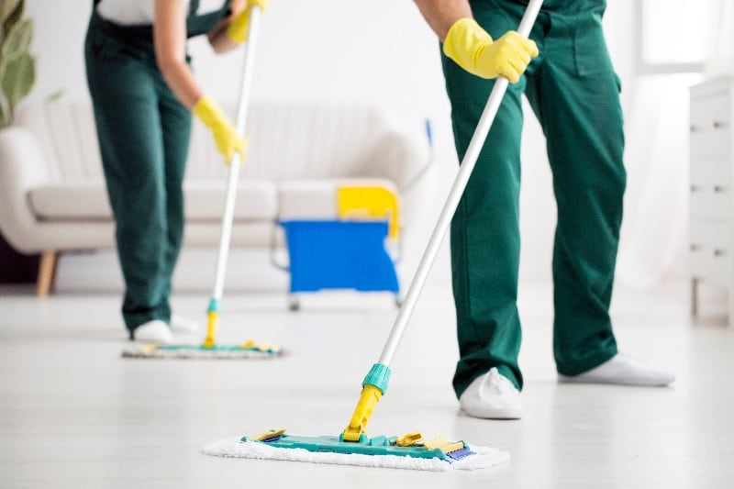
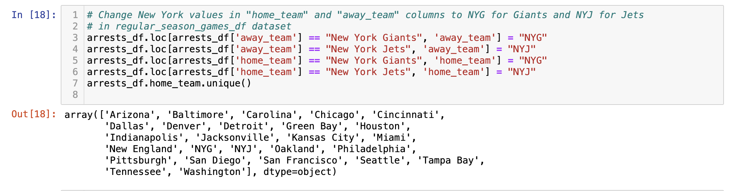
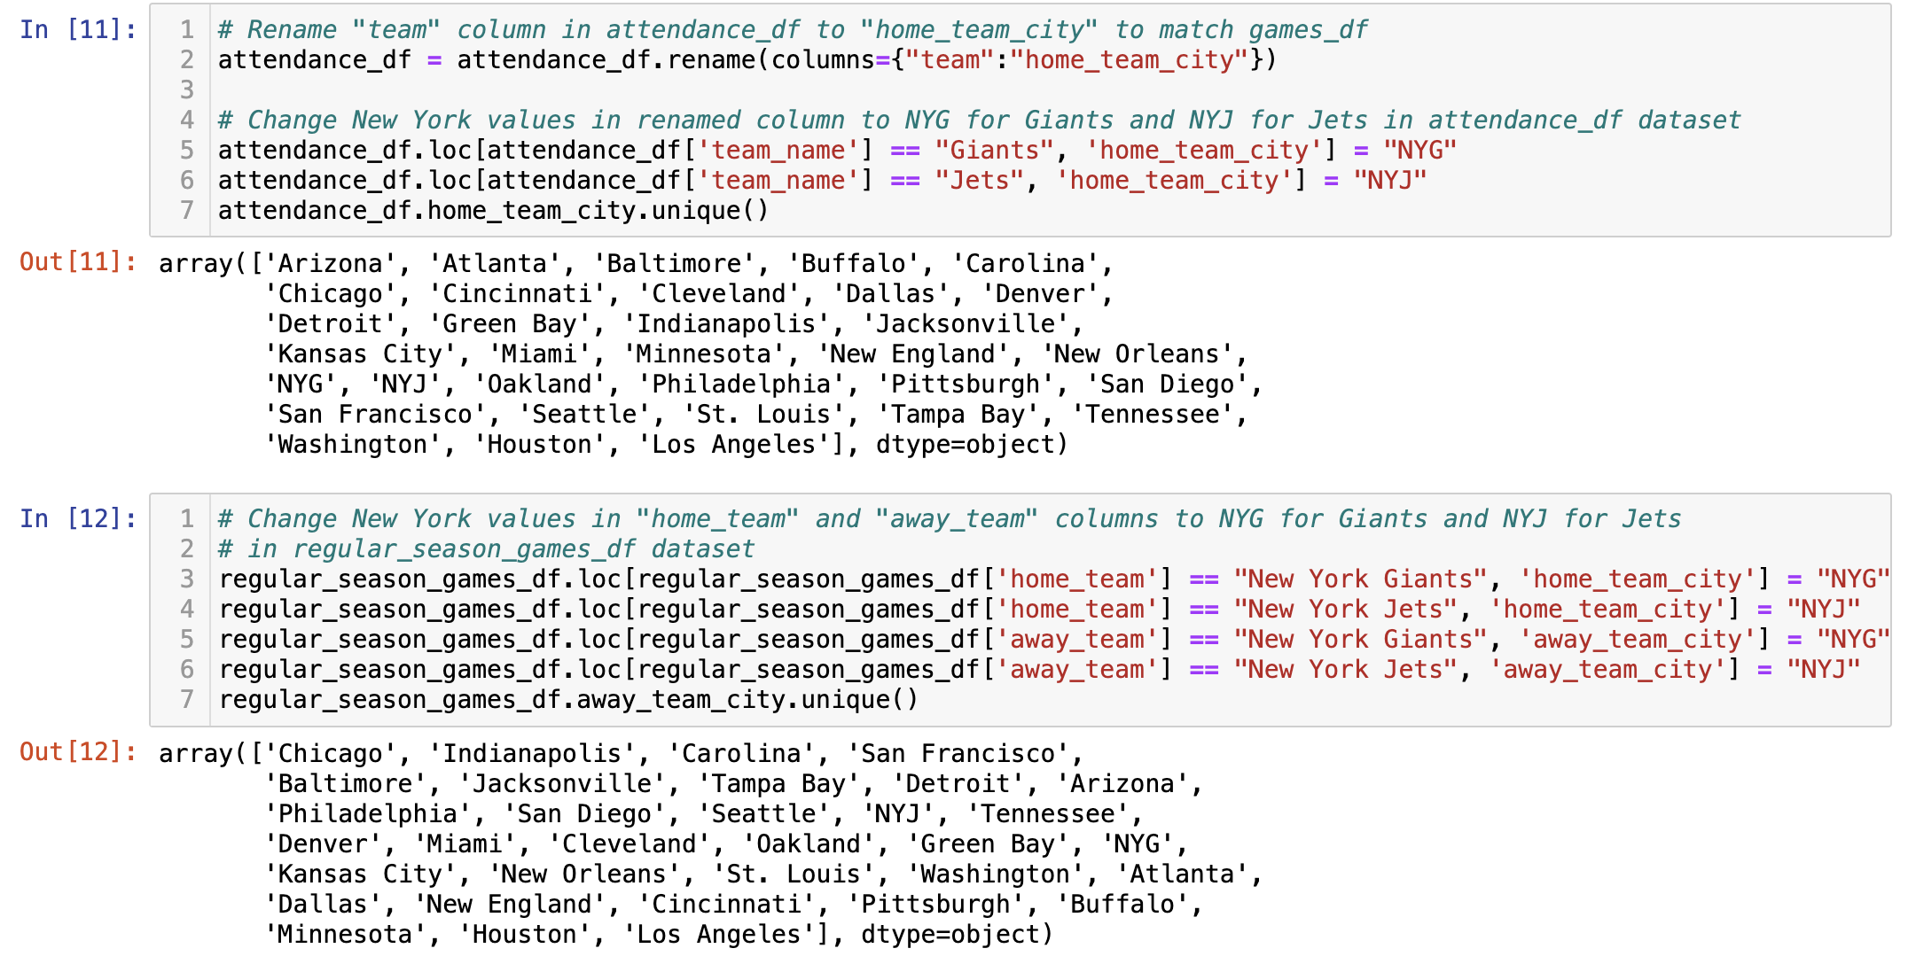
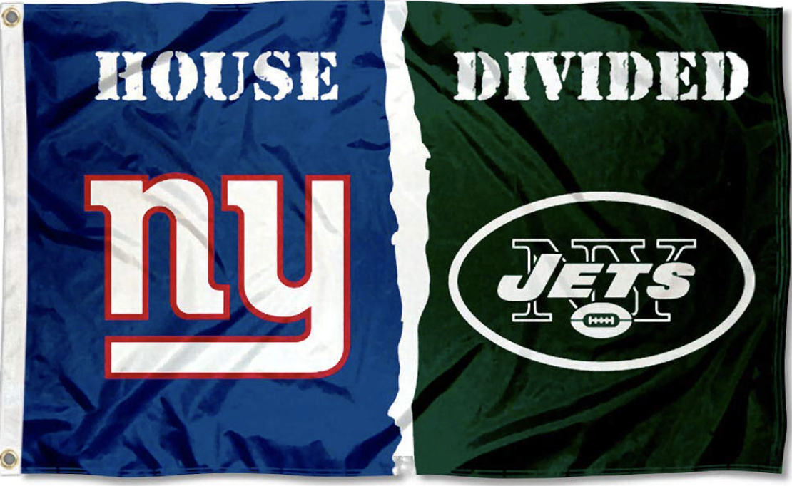
More Cleaning…
For all datasets, we changed the New York Giants and New York Jets ”home city” to NYG or NYJ, respectively.

Slide 7

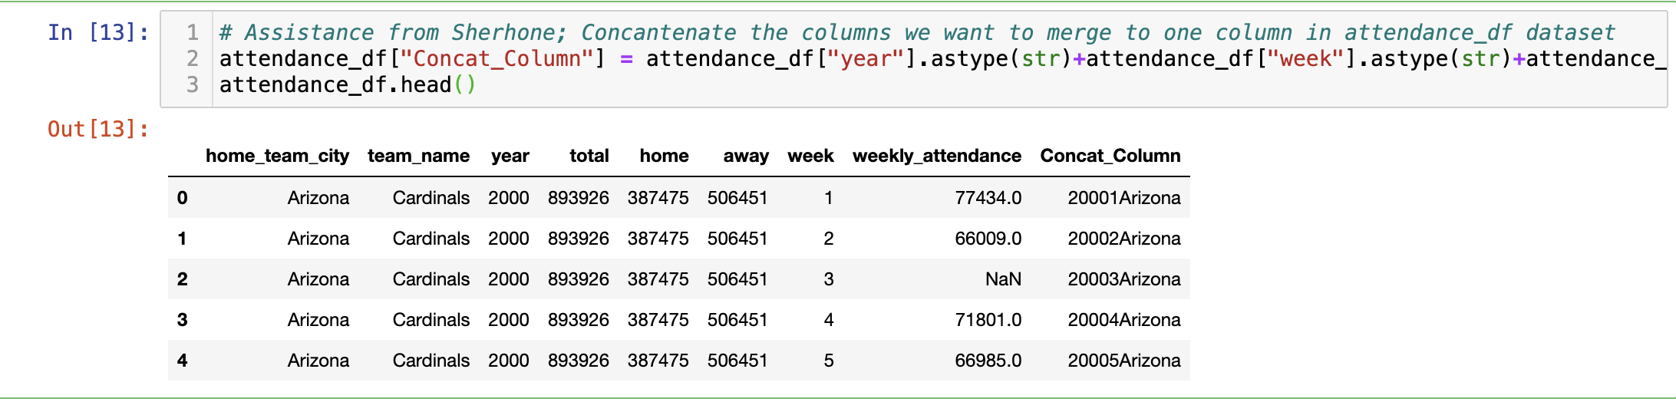
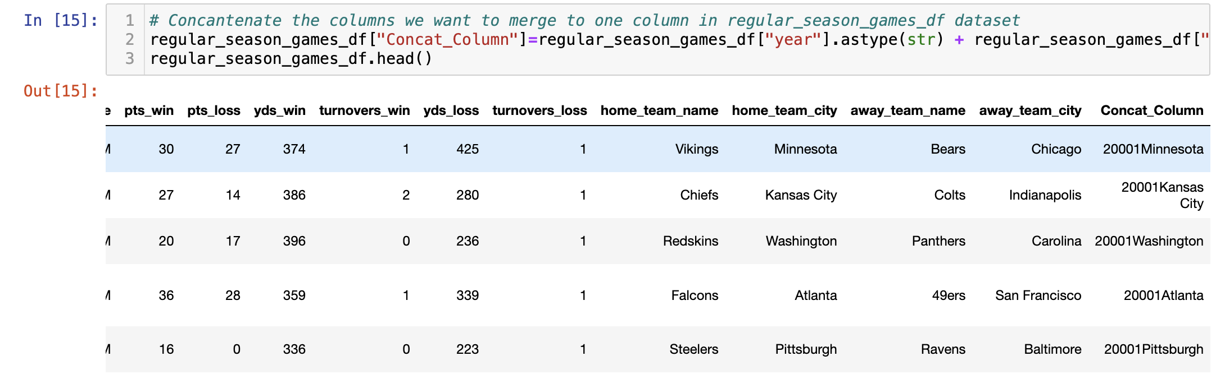
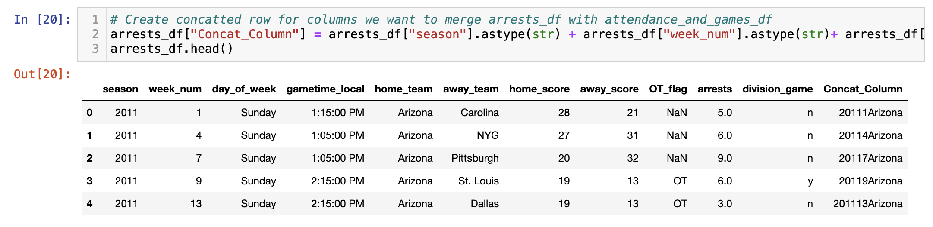
Merged Datasets (Concatenated Column)
Created a concatenated column for all 3 datasets to merge on (year, week, home team city)

Slide 8
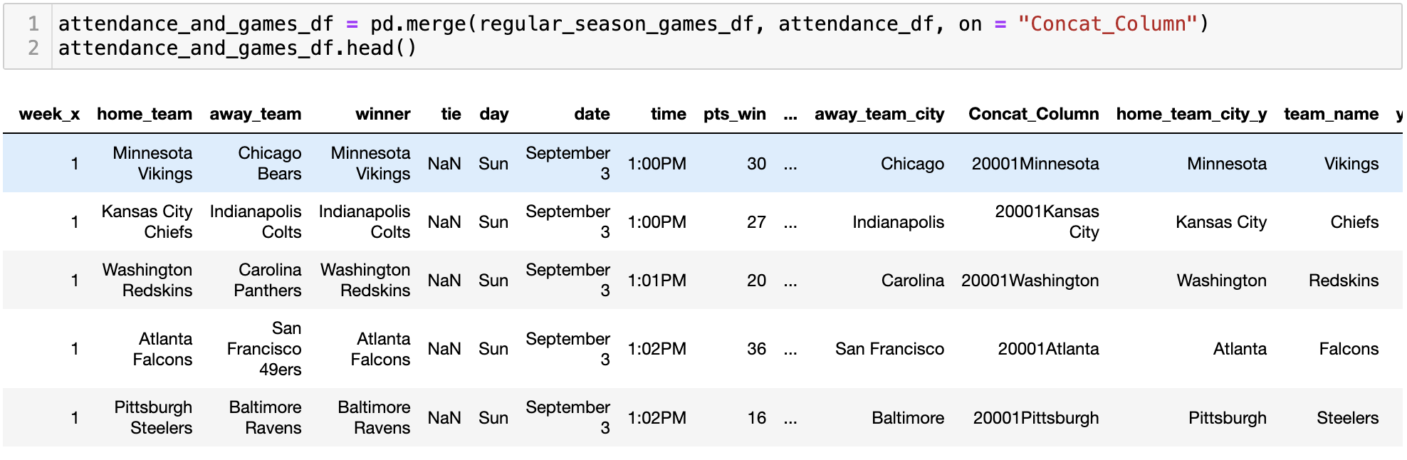
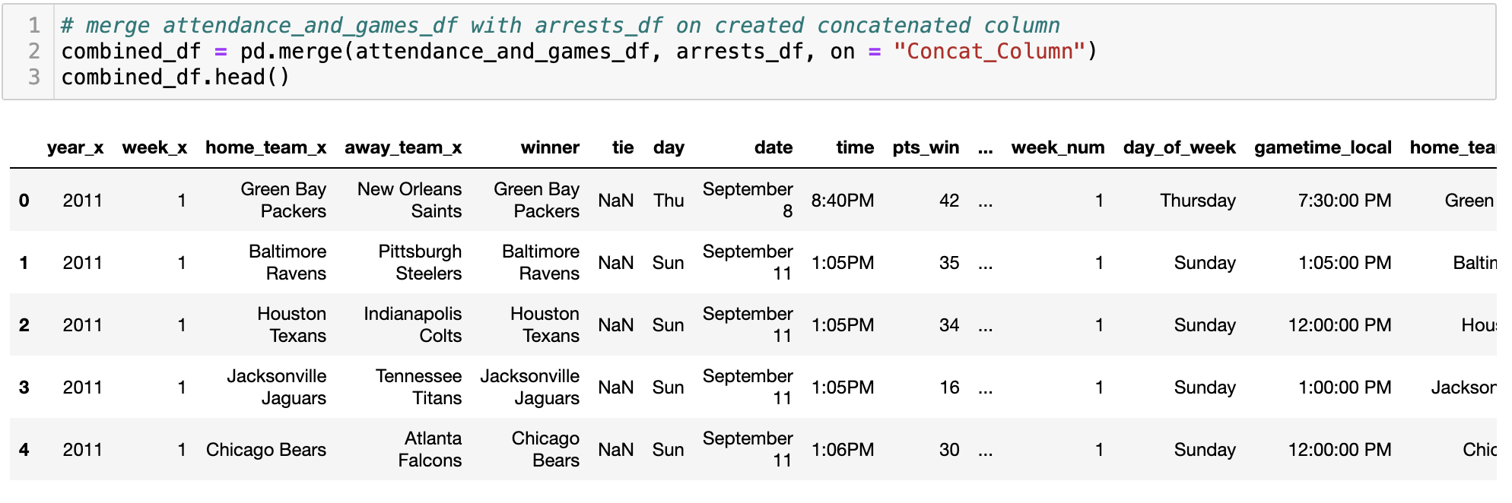
1. Merged Attendance and Games Dataset first
2. Merged first two combined datasets with Arrests dataset

Slide 9
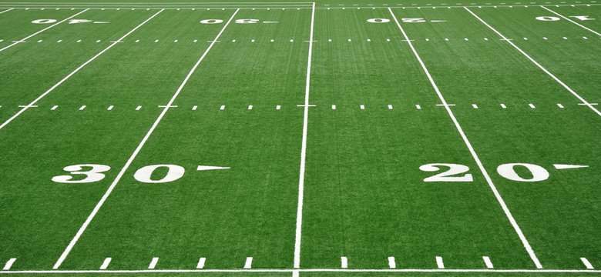
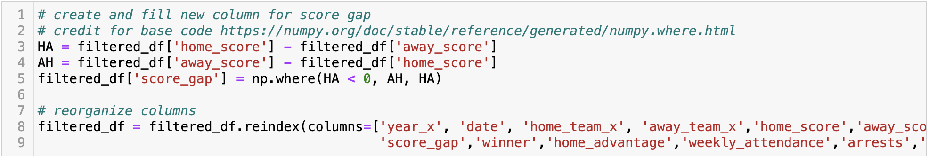
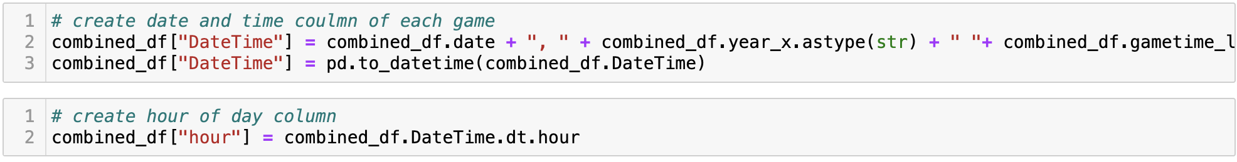
Columns Created
Score Gap (difference of score for each game)
Other Columns Created:
Home/Away team winner
Stadium Type (dome or not domed)
Hour (The hour of the day each game started)

Slide 10

Dataset Limitations
Arrests dataset did not include data for:
Atlanta Falcons
Buffalo Bills
Cleveland Browns
Detroit Lions
Minnesota Vikings
New Orleans Saints
St. Louis Rams (now Los Angeles Rams)
Arrests data was only 2011-2015 seasons
Attendance and Games data up to 2019 (3 seasons completed since)

Slide 11
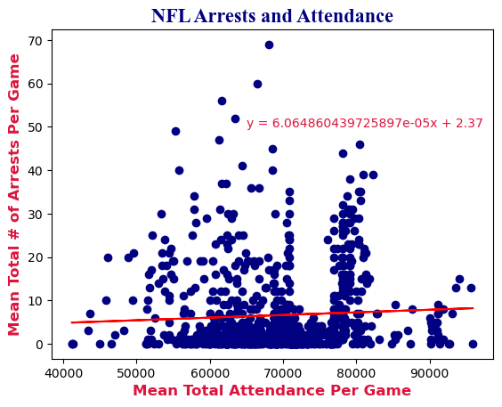
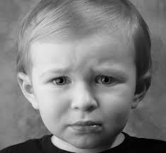
Correlation between Attendance and Arrests?
r = 0.053433 (No correlation)

Slide 12
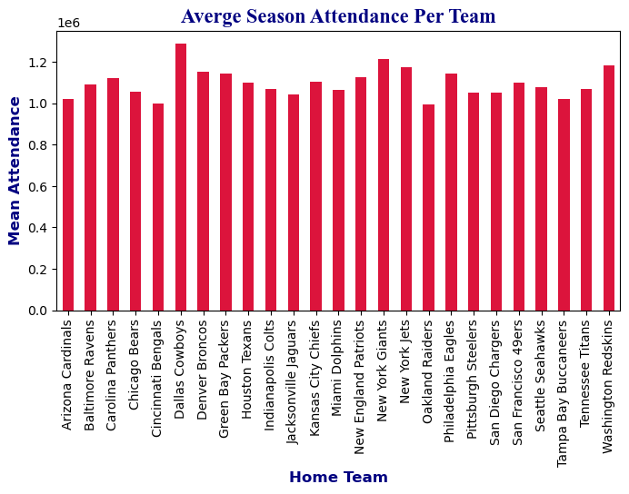
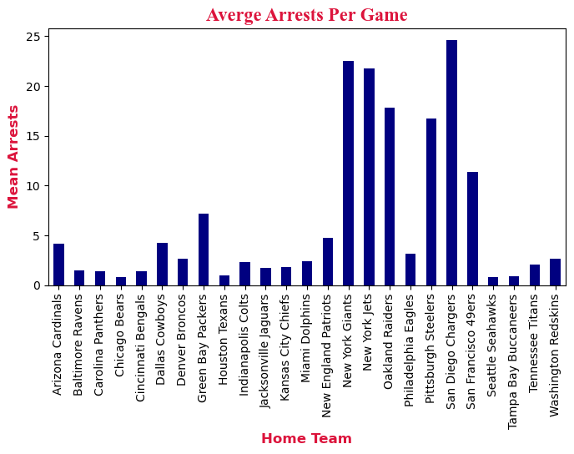
But we found…
Cowboys have the highest average total attendance in a season (about 1,280,000 attendees).
San Diego Chargers had (moved to Los Angeles in 2017) the most dangerous stadium (about 25 arrests per game).

Slide 13
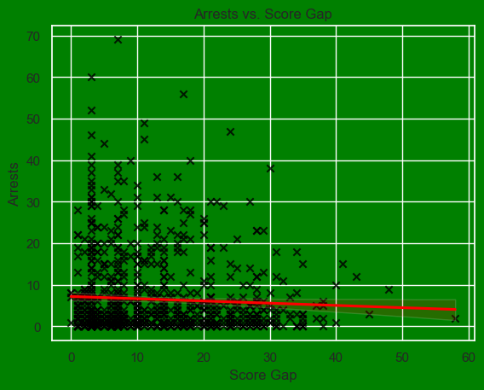

Correlation between Score Gap and Arrests?
r = -0.05286 (No correlation)
However, the visual shows the closer the score of a game there may be more arrests.

Slide 14
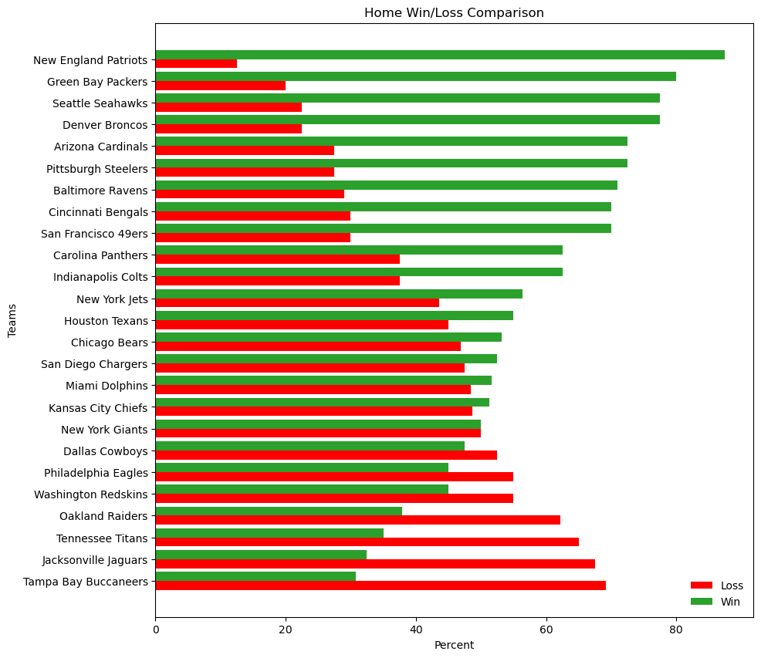
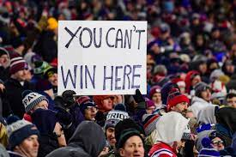
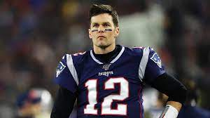
Home Advantage

Slide 15
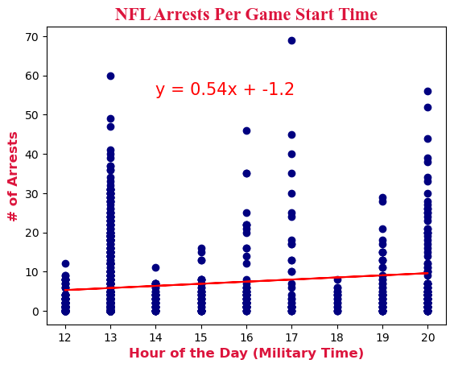
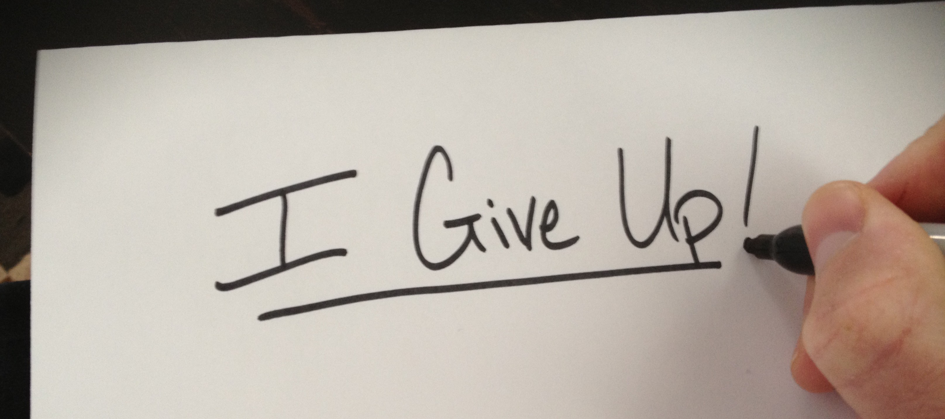
Correlation between Game Time and Arrests?
r = 0.146985 (Very weak Correlation)

Slide 16
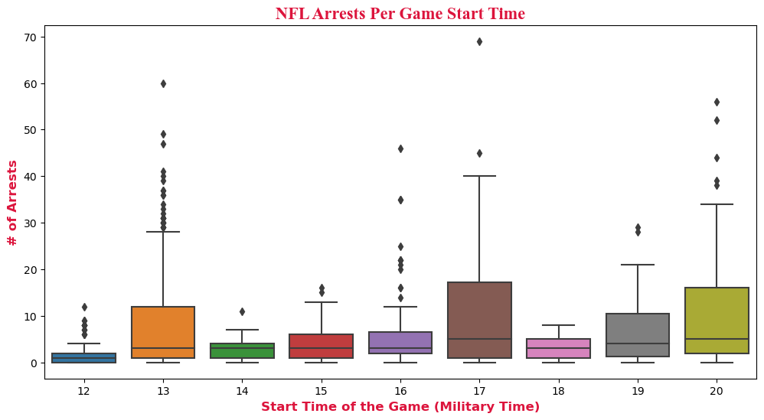
But we found…
games that start between 5:00 – 6:00 pm(respective local time), generally, have the most arrest (about 13 arrests per game). With 12:00 – 1:00 pm games the least (about 2 arrests per game)

Slide 17
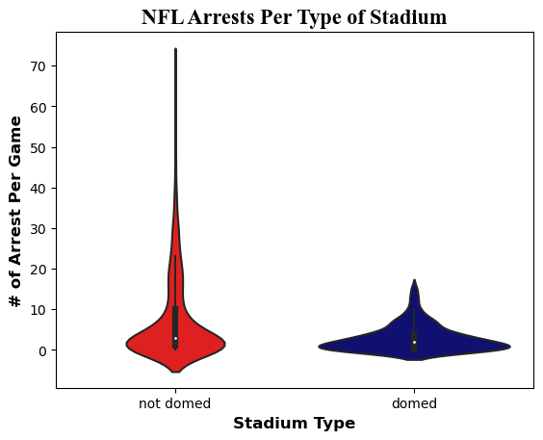
Stadium Type and Arrests
Only 5 teams within our dataset with domed stadiums (as of today 10 teams):
Arizona Cardinals
Dallas Cowboys
Houston Texans
Indianapolis Colts
New Orleans Saints
T-test shows there is a significant difference
P-value = 5.04e-22
Source: https://www.profootballnetwork.com/list-of-indoor-and-outdoor-nfl-stadiums-how-many-nfl-stadiums-are-domed/

Slide 18
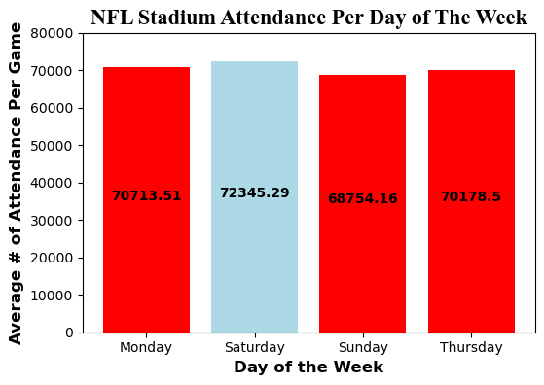
What day of the week has the best attendance?
Saturday games have the best attendance by average (very small population of Saturday games)
T-test showed there was no significant difference between Saturday and Sunday Games
P-value = 0.124
T-test DID show there was a significant difference between Monday and Sunday Games
P-value = 0.0524
*Wednesday was removed (there was one Wednesday game in 2012)*

Slide 19

Takeaways
From a league-wide lens, there is very little correlation (that we found) between game attendance, score gap, and time of day with the number of arrests during an NFL game.
Probably more correlation with city demographics and crime rate
San Diego Chargers had the most arrests (average per game). This could have been a part of the decision to move to Los Angeles in 2017.
Domed stadiums from our small sample show they have less arrests. Should more teams move to domed arenas?
Fun Fact: In 2011 Week 10, the Chargers vs Raiders game in San Diego had the most arrest in our dataset with 69 total !

Slide 20

To be considered…
Limitations
Bias
Arrests at NFL stadiums have bias with each respective city’s crime rate.
Stadiums vary in total seats available, so total attendance may not be a fair parameter (use percentage instead).
Some teams are just better than others, so they win more home games because they just win more games in general.
There are more games played on Sunday at 1:00pm than any other day or time.
Missing Data
Limited Population (2011-2015)
Data not up-to-date

Slide 21
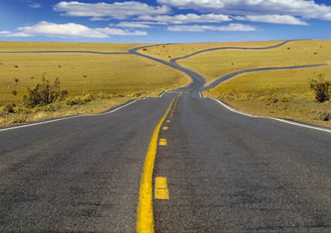
Moving Forward
What we would do differently?
For research questions not involving arrests (ex. home field advantage), use only Attendance and Game datasets
Use percentage of stadium attendance (attendance/stadium capacity)
What else would we do with more time?
Look for correlation of home city crime rate to average arrests per game
Look for correlation of how many police were on site to arrests per game
Look for correlation of alcohol sales to arrests per game
Look at correlations at a per team lens

